Slide 1
0x100 – Introduction to the Introduction
ECED4406 – Computer Security
Dr. Colin O’Flynn
Dalhousie University.

Slide 2
Recording Warning
Audio recording will be in use – I’ll let you know when it’s on & off. You can ask for it to be paused to ask questions if you wish. I’ll always provide time before & after the lecture content where unrecorded questions can be asked.

Slide 3
Note on Slides, Notes, and Accommodations
Slides will generally be high-contrast where possible with this simple “PowerPoint Default” design to improve recognition if using assistance technology.
Slides will be posted before classes as PDF (sometimes I forget – just ask in class if not there!).
Lectures are recorded and posted in Brightspace – normally right after class, if not there by end of day check in with me.

Slide 4
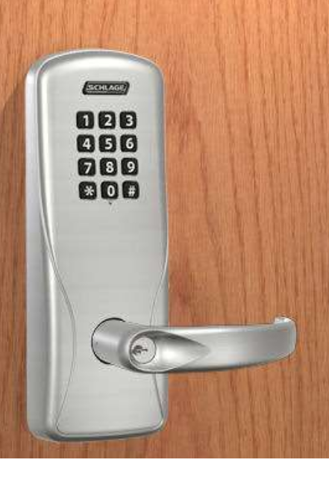
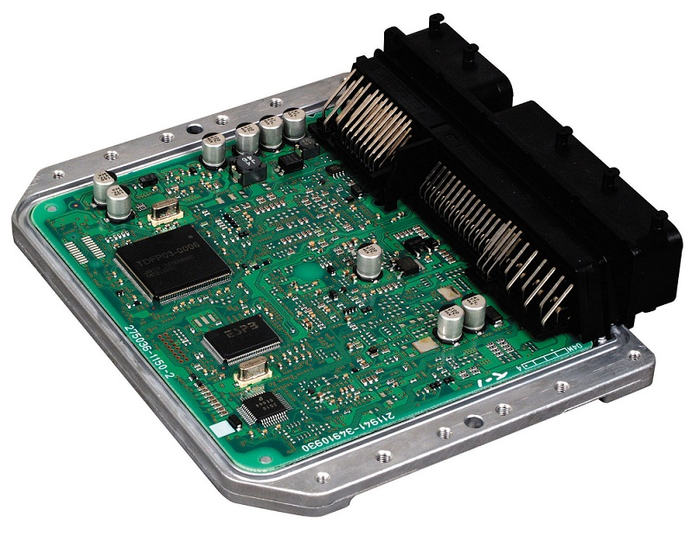
What is this course about?
Embedded system security, such as:
IOT Devices
Automotive Systems
How to secure embedded systems.
What is cryptography?
What is a root of trust, secure boot, etc?
What are security ratings?
How to break embedded systems.
Reverse engineering.
Fuzzing.
Hardware Attacks - Non-invasive.
Hardware Attacks - Invasive

Slide 5
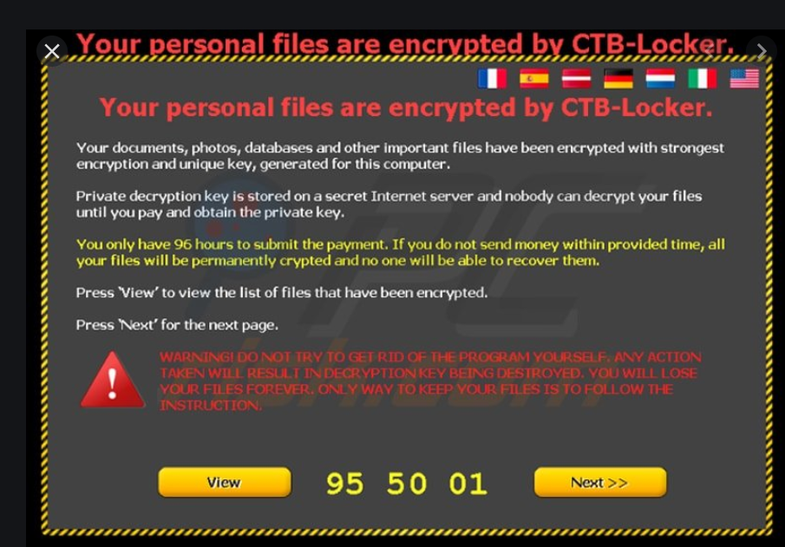

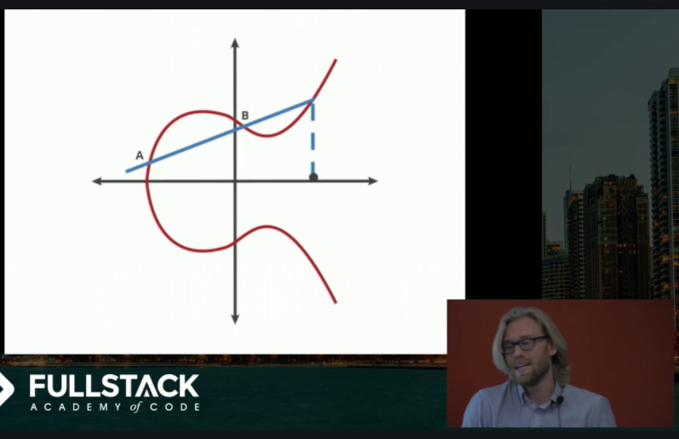
What is this course not about?
Web security & web security protocols.
HTTPS, SSL, etc.
Detail cryptographic algorithm development.
High-level application security (Windows, Linux, etc).

Slide 6
What should you already know?
The following words should mean something to you:
RAM.
ROM.
Stack frame.
Instruction registers.
Matrix multiplication.

Slide 7
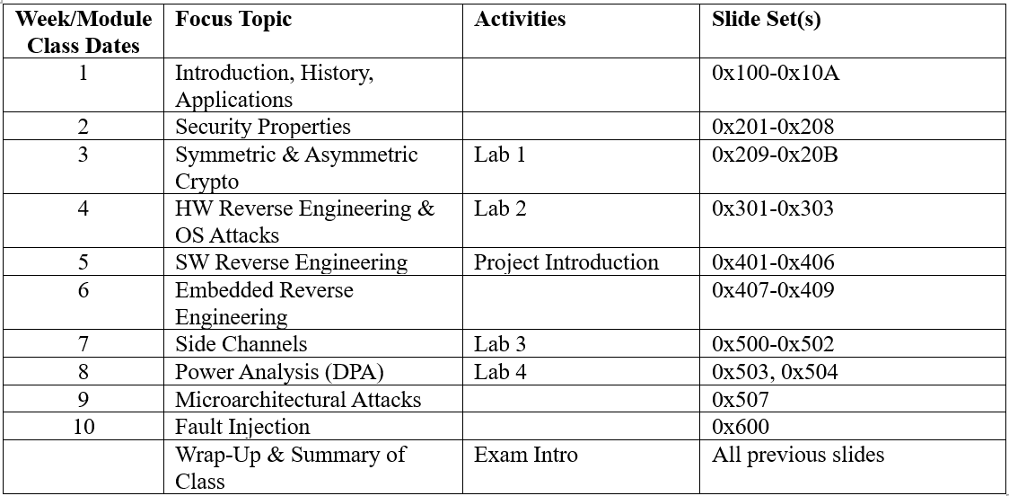
Rough Schedule of Lectures

Slide 8
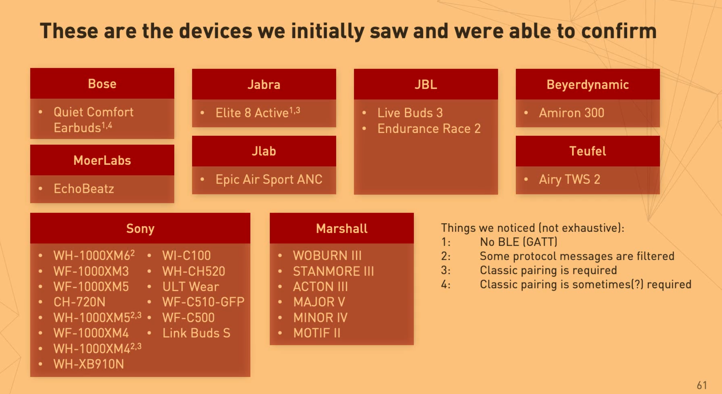
e.g., Example of Recent “In-Scope” Attack
https://media.ccc.de/v/39c3-bluetooth-headphone-jacking-a-key-to-your-phone#t=3545

Slide 9
Online to In Person
I previously taught this course online, this version is different (in-person).
Previous lectures are available (from 2020 year) at https://www.youtube.com/playlist?list=PLyAXNQGte3qNNbs8J3gE8JkpAJ9_OH75q .
Many things (especially assignments/labs) changed from previous years.
I try to always record lectures to post on Brightspace.
For online: “Lectures” were short – one class contains multiple lectures!
Slides this year are more consolidated

Slide 10
Course Lecture Style
Class schedule is roughly as follows each day:
Tuesday @ 1:05PM – 2:25PM (B227)
Thursday @ 1:05PM – 2:25PM (B227)
+ Labs on Wednesday 2:35-5:25PM (not every week)
I teach as well during the start of that timeslot, a TA will be running labs.
Classes will roughly follow the schedule each day:
2:35-2:45: Recap of previous lecture (possibly longer if needed).
2:45-3:30: New material / lectures (45 mins – ONLY this section recorded)
3:30-3:55: Questions & discussions (if needed)

Slide 11
Course Policies
If Dalhousie is closed due to snow event I will not send a notice, there is no class. If we have many cancellations I may need to record missing lectures (there is some “flex” built in right now) or will use Tutorial times.
If class will be cancelled for other reasons I will use Brightspace to announce this.
Lab/Tutorials tend not to run every week – look for a Brightspace announcement to confirm if a lab is running (NO LAB next week).

Slide 12
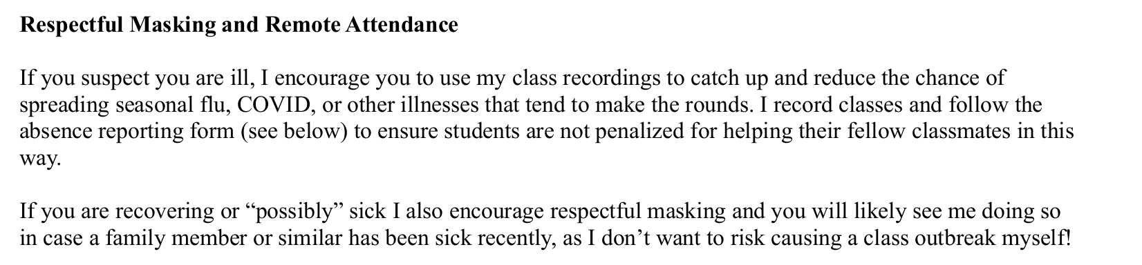
Course Policies (From Syllabus)

Slide 13
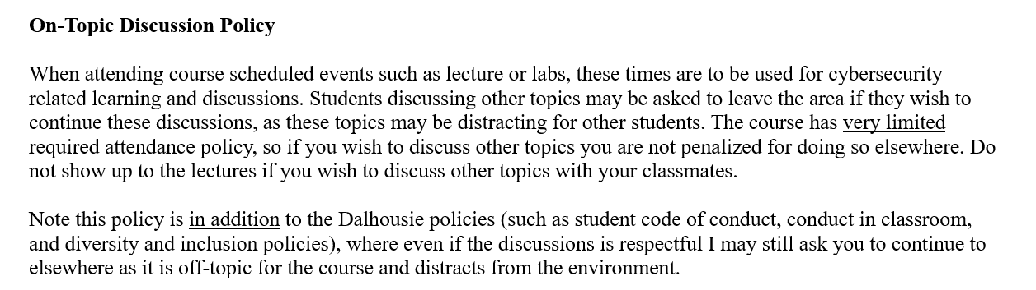
Course Policies (From Syllabus)

Slide 14
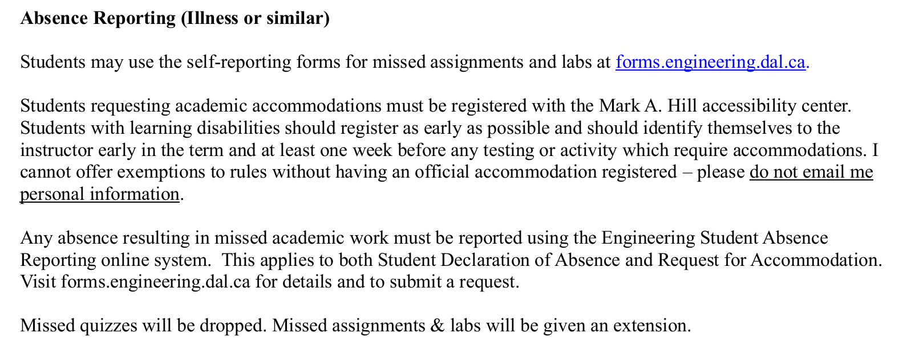
Course Policies (From Syllabus)

Slide 15
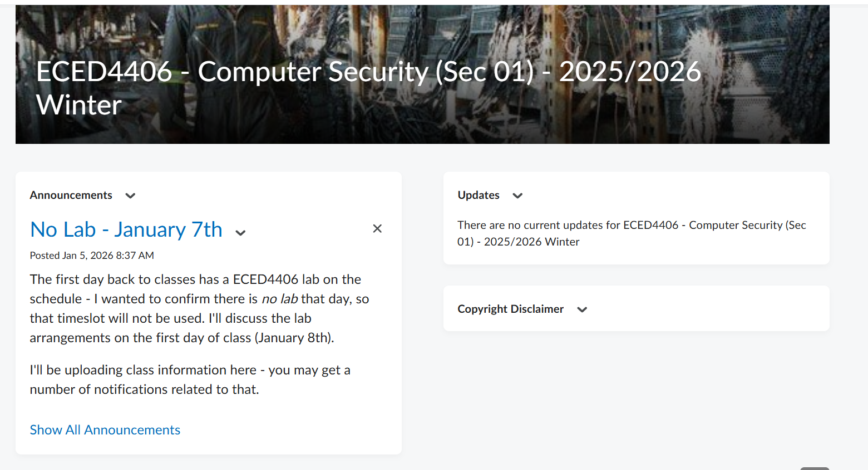
Brightspace

Slide 16
Quizzes
We will start quizzes next week – these cover some of the lecture topics.
They should hopefully reinforce what you’ve learned in the lectures.
They will run through the Brightspace system.

Slide 17
Assignments
2 assignments throughout the semester, completed individually.

Slide 18
Labs
Labs were previously run on everyone's computers.
Labs will be in the normal “lab room” and involve some hands-on material/tools, some computer-based labs.
Labs can be completed on your own time as well – especially computer-based ones.

Slide 19
Course Project
Course project will be a chance to apply some of what you’ve learned in this course.
More details coming next month once you have more background on the material.

Slide 20
Final
Final includes two aspects: a lab test (practical) and a classic written test (during exam time).
The lab exam is easy – if you personally can complete all the labs in the course, you shouldn’t have too much trouble.

Slide 21
Notes on Quizzes, AI, and Final Exam(s)
I follow Dalhousie’s AI policy – work submitted should be your own (see syllabus for full statement).
AI / LLM can be a very useful tool – it has limitations and I’ll be showing you some of these as part of the class. Understanding how to use a tool and when/where to use it is a core part of engineering.
I use the Final Exam as a validation of your personal knowledge – if you have completed assignments/labs yourself you’ll find them easy, if using AI to complete assignments you’ll find them difficult.

Slide 22
Course Questions For Me
Questions or Concerns?
coflynn@dal.ca
If not we’ll pick this up on the first “normal” lecture day to introduce the first topic.

